Slide 1

Default Guidelines for Better C++
Jan Wilmans
C++ under the sea 2025

Slide 2















About me
Software developer for 20+ years
Contributor to WG21, SG14 and SG1
Vimec: Quality Inspection of Medical Glass
C++Coach / Software Architect for Vimec
Co-Organizer C++ Meetup Eindhoven
https://www.meetup.com/nl-NL/cpp_meetup_eindhoven/
https://nullptr.nl
https://vimec.nl
Quality inspection of Medical Glass

Slide 3
The goal: Default guidelines
Use standard C++ and make it expressive, consistent, and opinionated — promoting clarity and safety through conventions rather than new syntax.
Not all guidelines are coding guidelines
Some are style recommendations
Some are part of the development process
Some are c++ code related

Slide 4
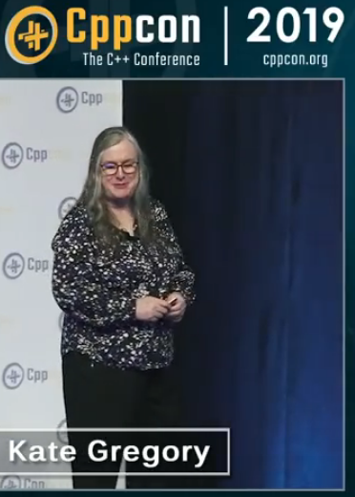
understandable code
  Make it more reader-friendly
    Use verbs in function names (express action)
    Use nouns in class and variable names
    Maintain consistent formatting (use clang-format / astyle)
    Minimize implicit conversions (warnings can help)
  Make Local reasoning possible
    Limit variable scope
    Minimize shared state (and avoid global state)
    Prefer functions that do one thing (single responsibility)
    Prefer const correctness!
CppCon 2019: Kate Gregory “Naming is Hard: Let's Do Better”

Slide 5
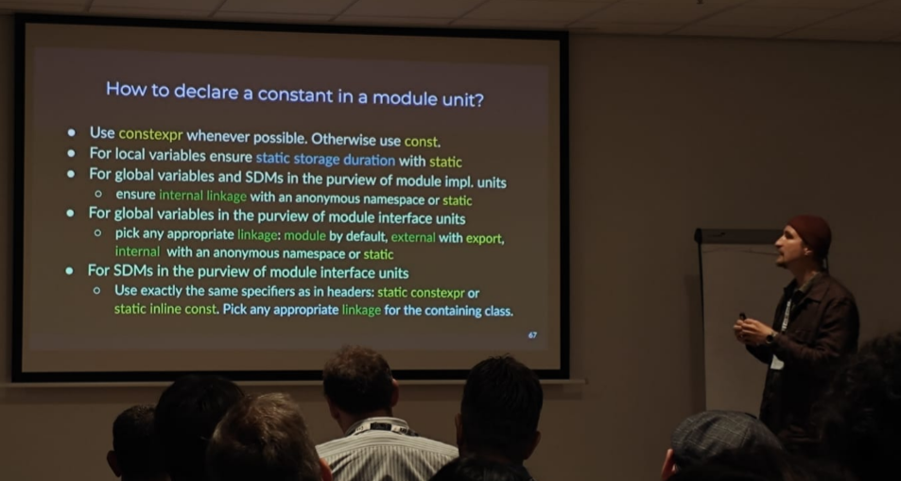
Mikhail:
constexpr!

Slide 6
Maintainable code
  Relies on correctness, which is a hard problem, but can be supported by process and tools:
  Code reviews
  Tests
  Build time checks
    Compiler warnings
    Sanitizers
    Spellings checkers (for comments)
    Safeguards in Continuous Integration (CI)

Slide 7
An incomplete diagram
Consistency
Naming
Understand
well-defined lifetimes
Readable
Maintainable
code
No shared state
Local Reasoning
Use const
Tests
Correctness
Sanitizers
CI Safeguards
bounds checks
proofs
Code Review

Slide 8
What is stopping us?
Just right good™ code? Wait, what does good code look like?
The answer may vary....
C++ serves many domains and developers, so it avoids prescribing a single way of doing things.
It favors flexibility and sometimes even safety! over enforcing a programming style, mostly for the sake of performance.
C++ views backwards compatibility an important asset.
But it has also become known for being the language that has:
the wrong defaults™

Slide 9
common headaches
manual memory (resource) management
globally defines types and variables (un-scoped enums)
non-virtual destructors
unsafe access by default (unchecked boundaries)
implicit conversions
interestingly: in C++ “default initialization” means “no initialization”
lack of const member functions
mutable variables (arguments, locals and members) that never change
discarded return values (no error checking)
unscoped standard library classes, like thread and mutex (fixed by std::jthread and std::lock_guard)
Most have to do with Lifetime, Scope and Lack of local Reasoning.

Slide 10
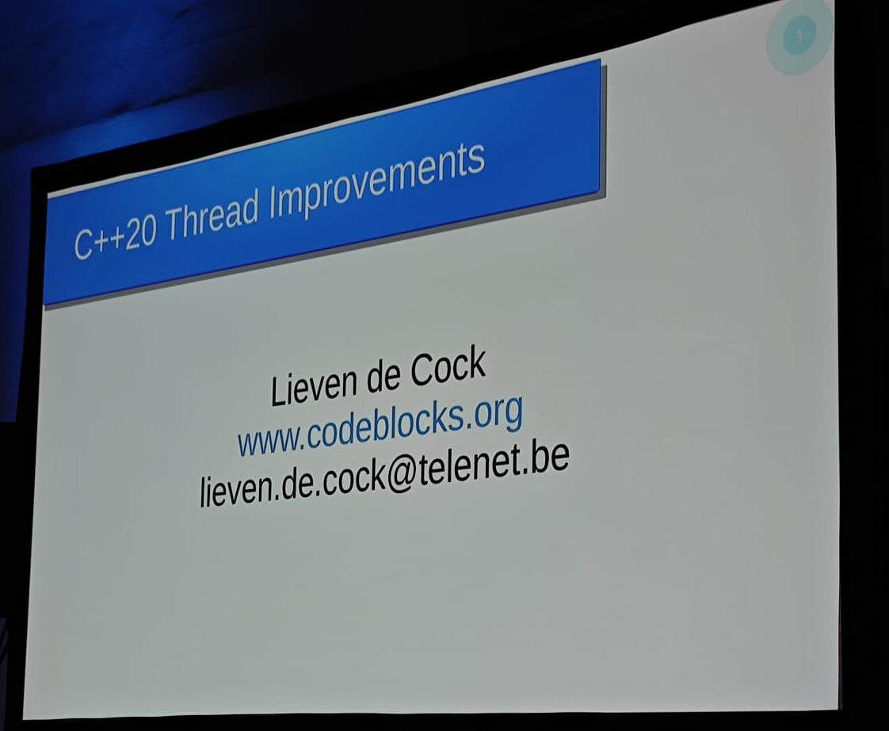


Lieven de Cock

Slide 11
Where to find good defaults?
Company guidelines (often domain specific)
C++ Core Guidelines (1104? and counting)
Experience

Slide 12
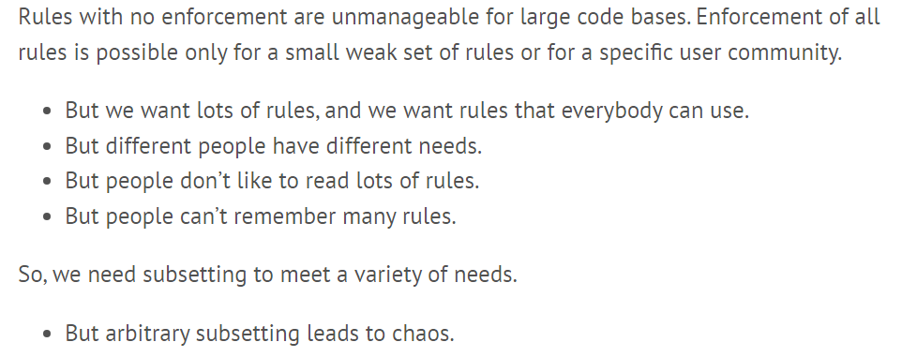

Quote from the C++ Core Guidelines:
yes
yes

Slide 13
let’s create a small set of weak rules!
I did not invent new guidelines
They were gathered from existing material
  filtered for clarity
  simplified to be practical
  prioritized to set defaults
Simplification makes them more accessible
Prioritization gives ready-to-use defaults

Slide 14
C++ DEFAULT Guidelines
These defaults are an ordered subset of common Guidelines that I use on daily basis.
You do not necessary need use this set of defaults, the important thing is to have a set of defaults
Guidelines are not hard Rules, use them responsibly!

Slide 15
Guidelines, not rules
If you can use a default, use it.
If the default does not seem fitting, that is great, because that means that you already are thinking about the problem!
When you are not following the defaults, it might be a great time to:
introduce a function whose name explains what is happening.
add a comment explaining why you decided to deviate.

Slide 16
  Turn on warnings! and use sanitizers
  No raw loops
  Avoid global mutable state
  Keep the scope of variables and type declarations as limited as possible
  Initialize all variables at declaration
  Use const whenever you can
  Use [[nodiscard]] for all const member functions returning a value
  Avoid returning values using arguments
  Use automatic resource management (RAII)
  Follow the rule of 0 or the rule of 5 in that order
  Avoid owning raw pointers
  Avoid manual memory management using new, delete, malloc, free,...
  Do not use C-style casts
  Do not add member variables to classes that are used as interfaces
  Do not use protected member variables.
  Avoid the use of volatile, const_cast, reinterpret_cast, typedef, register, extern, protected and va_arg
  Make all destructors of classes used in runtime polymorphism virtual
  Avoid references as data members of a class

Slide 17
1. Turn on warnings! and use sanitizers
A good start ....
GCC
-Werror -Wconversion -Wsign-conversion -Wall -Wextra -Wpedantic -Wdeprecated
-fsanitize=address,undefined
Clang
-Werror -Wconversion -Wsign-conversion -Wall -Wextra -Wpedantic -Wdeprecated
-fsanitize=address,undefined
MSVC
Just having /W3 is a really good start, but /W4 is even better.
/W4
Notice: we do not have -Wconversion -Wsign-conversion as errors, but for new project they are great.

Slide 18

MOAR WARNINGs
GCC and CLANG
add_compile_options(
-Wall
-Wextra
-pedantic
-Wcast-align
-Wformat=2
-Wmisleading-indentation
-Wmissing-include-dirs
-Wnull-dereference
-Wswitch-enum
-Wunused
-Wunused-variable
-Wunused-parameter
-Wvla
# Warnings that are not allowed in C compilation units
$<$<COMPILE_LANGUAGE:CXX>:-Wnon-virtual-dtor>
$<$<COMPILE_LANGUAGE:CXX>:-Woverloaded-virtual>
)

Slide 19
MOAR WARNINGs
MSVC
/W4
/w14242 /w14254 /w14263 /w14265 /w14287 /w14289 /w14296 /w14311 /w14545 /w14546
/w14547 /w14549 /w14555 /w14640 /w14826 /w14905 /w14906 /w14928

Slide 20
dealing with existing warnings
Example:
We have a bunch of conversion of ‘int’ to ‘size_t’ warnings in existing code.
To make sure we do not introduce warnings in other categories, we use –Werror, but
allow sign-conversion to be a warning for the time being.
-Werror
-Wno-error=sign-conversion
-Wno-error=<warning> turns that specific rule back into a warning even if
-Werror was specified

Slide 21
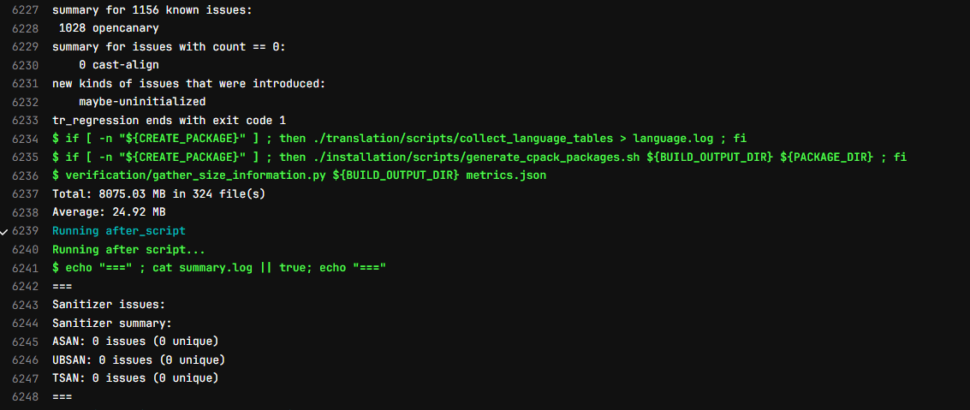
RUN tests with sanitizers

Slide 22
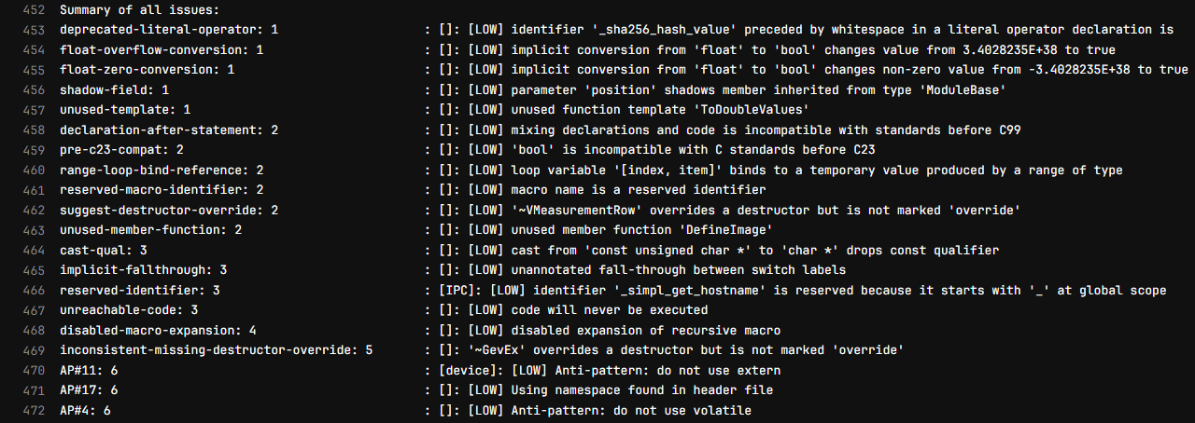
collect reports from CI BUILDs

Slide 23
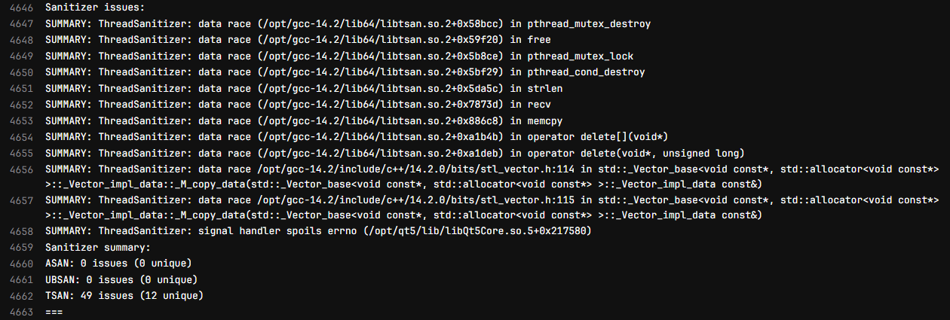
collect reports from CI BUILDs

Slide 24
TSAN false positives
TSAN_OPTIONS="suppressions=${CI_BUILD_DIR}/gitlab/tsan_suppressions"
mutex:libueye_api.so
deadlock:libueye_api.so
signal_handler_errno:libQt5Core.so

Slide 25
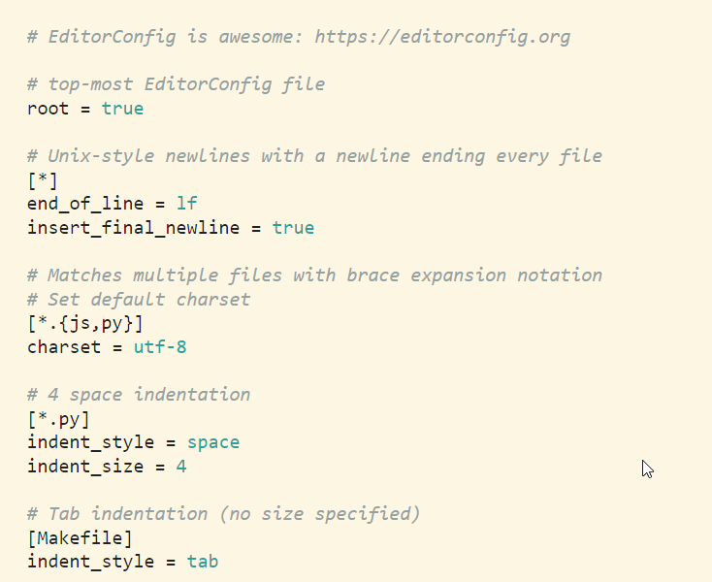
clang-format & Editorconfig
We have a repository specific clang-format file that was modified to approximate the existing style.
We check the style in the build for every commit and set editors to format-on-save.
We fail the build in a pre-build verification step for violations of:
whitespace style
spelling errors (not yet)
Editorconfig can help to make tab/space settings consistent
text encoding
tab/space setting
end of line setting
end of file newline
https://editorconfig.org/
https://clang.llvm.org/docs/ClangFormat.html

Slide 26
open canary
A set of scripts for aggregation, analysis and reporting of build and static analysis results.
Its purpose is to give you a failing CI build if new issues are introduced and to generate a team specific prioritized list of issues to work on.
https://github.com/janwilmans/OpenCanary

Slide 27

now on to actual coding guidelines

Slide 28
no raw loops
A whole category of out-of-bounds issue is solved by using range-based for and/or ranges.
Their interface makes them very hard to use incorrectly and they allow you to express your intent more clearly which improves readability.

Slide 29

Avoid global mutable state
An incredible source of errors and hard to understand code.
Mainly due to lack of local reasoning.
To understand when state changes, you not only have to read all functions that access it but also know when they are invoked and how. (on different threads? how often?)

Slide 30
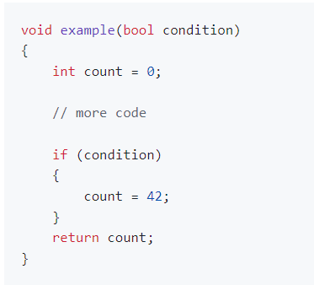
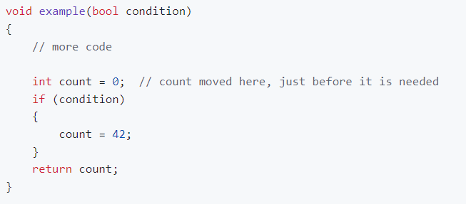
Limit scope
Keep the scope of variables and type declarations as limited as possible

Slide 31
Initialize all variables At declaration
Trivial cases:
int size = 0;
const int offset = 0; // const forces initialization
struct Point
{
int x = 0;
int y = 0;
};
Point p; // initialized by default!
notice that it is no longer possible to create an uninitialized Point here!

Slide 32
Initialize all variables At declaration
Non-Trivial case:
auto result = Result::Good; // mutable
if (var > value)
{
result = Result::Bad;
}
// instead, could be const by using the ternary operator
const auto result = (var > value) ? Result::Good : Result::Bad;
Notice `result` can be const here

Slide 33
Initialize all variables At declaration
using an Immediately Invoked Function Expression (IFFE)
const auto details = [&client]() -> DeviceDetails {
try
{
return client.GetDeviceDetails(); // 3rd party API
}
catch (const std::exception &)
{
// details not available for this client
return {};
}
}();
Notice that `details` can still be const here.
And we could also have created a free function...

Slide 34
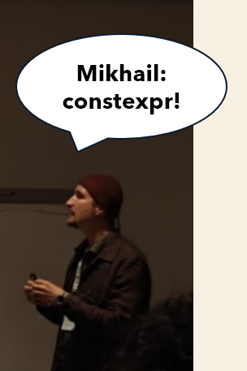
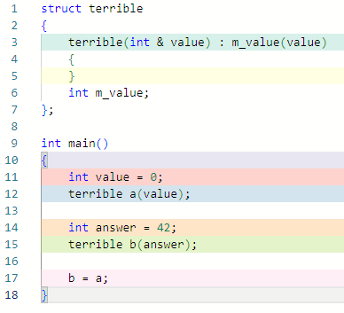
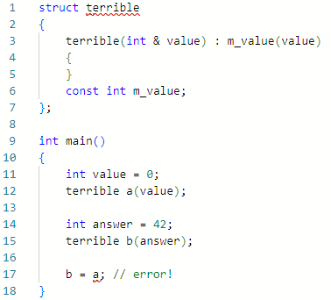
Use const whenever you can
Using const on variables makes code easier to read and less error-prone because you can’t assign it by mistake.
“Whenever you can” – When not?
https://godbolt.org/z/5dvMEvdoe

Slide 35
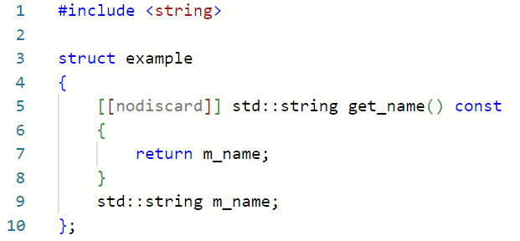
Use [[nodiscard]]
Use [[nodiscard]] on all pure free functions and const member functions
that do have side-effects
Rationale: const functions can't modify the object, so the only reason to call them is to get the return value.

Slide 36

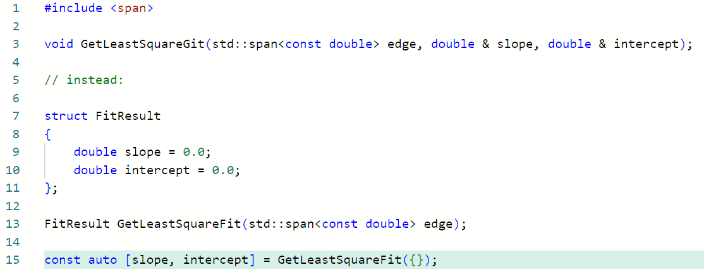
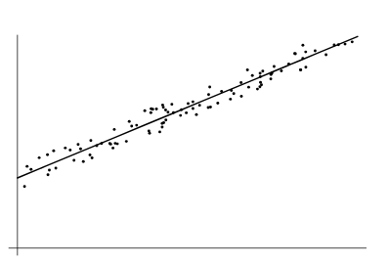
Avoid returning values using arguments
Rationale: breaks local reasoning for the caller, making reading and understanding the code harder.
https://godbolt.org/z/8r3vGn7a4
Notes:
add initialization by auto [ab]

Slide 37
Use automatic resource management (RAII)
+ Follow the rule of 0 or the rule of 5 in that order.
class rule_of_zero
{
std::string cppstring;
public:
rule_of_zero(const std::string& arg) : cppstring(arg) {}
};

Slide 38

Use automatic resource management (RAII)
+ Follow the rule of 0 or the rule of 5 in that order.
If a class requires a user-defined destructor, a user-defined copy constructor,
or a user-defined copy assignment operator,
then implement all of them and add a move constructor and move assignment operator.
class example
{
public:
example(const example&) = default;
example(example&&) = default;
example& operator=(const example&) = default;
example& operator=(example&&) = default;
~example(); // implemented
};
Notice: copy/move assignment operations will not be default in practice

Slide 39
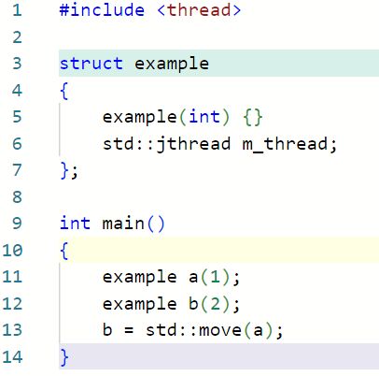
Simplification:
Two kinds of classes
Classes that have custom destructors deal exclusively with ownership,
other classes should not need custom destructors.
Single Responsibility Principle
RAII
Automatic Resource Management
https://en.cppreference.com/w/cpp/language/rule_of_three.html

Slide 40
Do not use C-style casts
In general, casts other then static_cast should be considered a code smell, and probably warrants the code to be separated into a function that explains a ‘why’.
Rationale: C-style casts are less explicit and more prone to errors compared to C++-style casts (static_cast, dynamic_cast, const_cast, reinterpret_cast).
C++ casts provide better type safety and are easier to search for and review. They make the intention of the cast clearer, which improves code readability and maintainability.

Slide 41
More defaults
Avoid manual memory management using new, delete, malloc, free,...
Do not add member variables to classes that are used as interfaces
Do not use protected member variables.
Avoid the use of volatile, const_cast, reinterpret_cast, typedef, register, extern, protected and va_arg
Make all destructors of classes used in runtime polymorphism virtual
Refer to the guidelines document for details and rationales:
https://github.com/janwilmans/guidelines/blob/main/guidelines_details.md

Slide 42

document Exceptional code
To keep code simple and safe.
Sometimes, ugly, unsafe, or error-prone techniques are necessary
for logical or performance reasons. If so, keep them local and well documented.

Slide 43
Least surprising behavior
In summary: use default guidelines if you can.
Why? Because it is the default and therefore gives the
least surprising behavior.

Slide 44
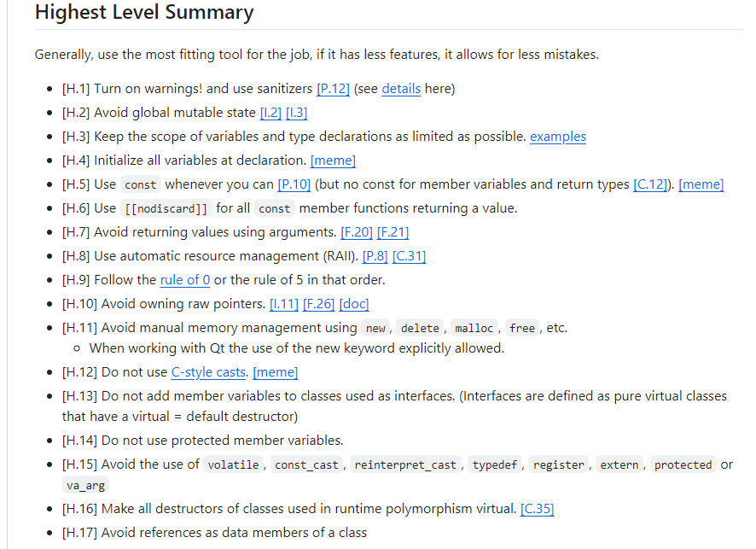
website, living document
https://github.com/janwilmans/guidelines

Slide 45
Take-aways
defaults are better than just guidelines
shared defaults (conventions) are better still
Maybe in 20 years?
conventional c++ ?

Slide 46
  The Default Guidelines can be found here:
  https://github.com/janwilmans/guidelines
THANK YOU!
Questions?
blog: nullptr.nl
janwilmans.bsky.social
janwilmans@toot.community

